Slide 1
Mediator
Behavioral Pattern

Slide 2
Mediator Pattern: Definition
Mediator object coordinates communication between interacting objects.
Interacting objects work with and through a Mediator rather than each other directly.
The Mediator pattern is also known as a “glue” pattern.
The Mediator pattern decouples the individual tasks.
  Each object only knows its own input and output.
  This way, each object does not depend on the other objects around it.

Slide 3
Mediator Pattern: Illustration
Client or
User
Object A
The “Before” Model
Object B
Object C
Object D

Slide 4
Mediator Pattern: More Illustration
Client or
User
Object A
Object B
Colleague
objects
Mediator
Object
Object C
Object D
The “After” Model
Abstraction

Slide 5
Mediator Pattern: Structure
Mediator
colleague classes

Slide 6
Example: Graphic UI
director
DialogDirector
Control
ShowDialog()
CreateControls()
HandleChange(Control)
director->
HandleChange(this)
Select()
ListDialog
ListBox
EntryField
CreateControls()
HandleChange(Control)
• DialogDirector is an abstract class that defines the overall infrastructure of a dialog. It keeps a reference to the window that presents the dialog.
• Clients call the ShowDialog operation to display the dialog on the screen.
• CreateControls and HandleChange are abstract operations.
• DialogDirector subclasses override CreateControls to create the proper controls and HandleChange to handle the changes.

Slide 7
Graphic UI Example: Interaction Diagram
Mediator
Colleague
Client
DialogDirector
ListBox
EntryField
HandleChange
GetSelection
ShowDialog
SetText

Slide 8
Participants
Mediator (DialogDirector)
  implements cooperative behavior by coordinating Colleague objects.
  stores state.
Colleague classes (ListBox, EntryField)
  implements pieces of the cooperative behavior.

Slide 9
Collaborations
Colleagues send/receive requests to/from a Mediator object.
The Mediator implements the cooperative behavior by routing requests between the appropriate Colleague(s).

Slide 10
Mediator Pattern:Restaurant Example
It is time for breakfast. A customer places an order and gives it to the egg cooker.
The egg cooker does his job and then moves the order to the fry cook for meat and hash browns. The fry cook sends the plate on, and so forth.
When the order has finished processing in the kitchen the customer’s name is called and the plate is given to the customer.
This scheme is inflexible because you cannot change the structure of the kitchen and you cannot add any other steps to the cooking processes.

Slide 11
Mediator Pattern: Restaurant Example
Customer in
a restaurant
Eggs
Fry
Toast
The “Before” Model
Fry2

Slide 12
Mediator Pattern: The Solution
Customer in
a Restaurant
Eggs
Fry
Colleague
objects
Waitperson
Fry2
Toast
The “After” Model
Abstraction

Slide 13
Mediator Pattern: More on The Solution
Each of the objects knows only of the Mediator existence . Each performs its task and returns its finished product to the Mediator.
Flexibility is added because:
  Each individual object is free to change its own methods without effecting the others and without the other’s knowledge. This allows for dynamic binding and polymorphism.
  An additional process may be added. This would require a change in the Mediator object.

Slide 14
Mediator Pattern: Advantages
Moves complexity out of the problem domain solution (mainline routines). Abstraction hides some non-essential implementation details.
Changes or improvements to the underlying functions and objects do not require changes to client code.
Frees up individual colleague objects by decoupling them.
Enhances the chance for extensibility in the colleague objects since changes to individual colleagues do not ripple through to other colleagues and affect overall dependencies.
Different Mediator objects can provide a different set of services to the client by reusing colleague objects.

Slide 15
Mediator Pattern: Disadvantages
If the Mediator becomes too complex, extensibility of the Mediator may be limited without significant rework. Do not allow the Mediator to become a “special case” handler.
If the degree of complexity that you are moving from the Colleague into the Mediator is small then extra overhead of Mediator development may not be justified.
Decision made by the Mediator have to “jive” with what the Mainline routines expect. In other words, “Can you trust your Mediator’s decisions?”

Slide 16
Mediator Pattern:
When It Should be Used
When we have a group of colleagues that interact in complex but well-defined ways.
When the order of individual colleague operations might change.
Relieve colleague objects from the additional burden of mediation in addition to their regular services.

Slide 17

Discussion Questions
(T) for true or (F) for false
( ) 1. The Mediator pattern replaces many-to-many interactions with one-to-many ones between mediator and colleagues, which are easier to understand, maintain, and extend.
( ) 2. A common use of the Mediator pattern is to keep track of instances of a certain class.
( ) 3. One of the application of the Mediator pattern is to coordinate complex updates.
( ) 4. The Mediator pattern coordinate communication between interacting objects.

Slide 18
Broker Design Patterns: Façade and Mediator

Slide 19
Broker Pattern Structure
The Client must access the Broker and the Broker must access the Supplier
Most Broker patterns elaborate this basic structure

Slide 20
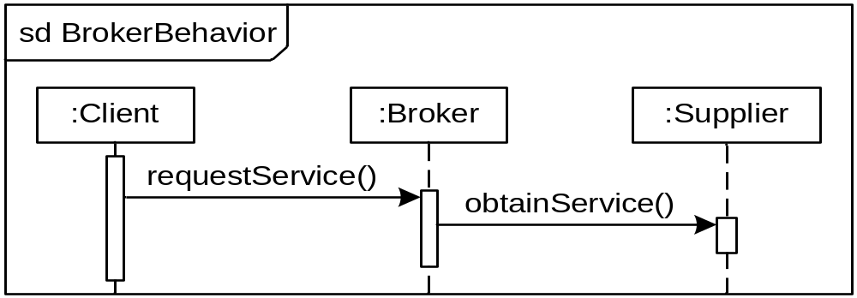
Broker Pattern Behavior

Slide 21
Broker Pattern Advantages
Simplify the Supplier—A Broker can augment the Supplier’s services.
Decompose the Supplier—A complex Supplier can offload some of its responsibilities to a Broker.
Facilitate Client/Supplier Interaction—A Broker may present a different interface, handle interaction details, etc.

Slide 22
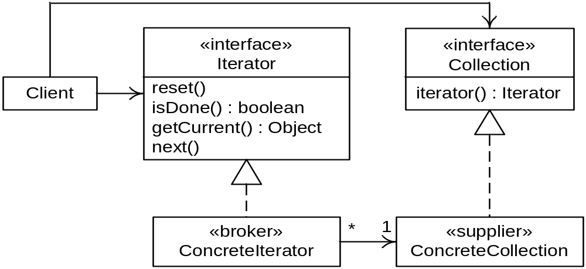
Broker Example: Iterator Form

Slide 23
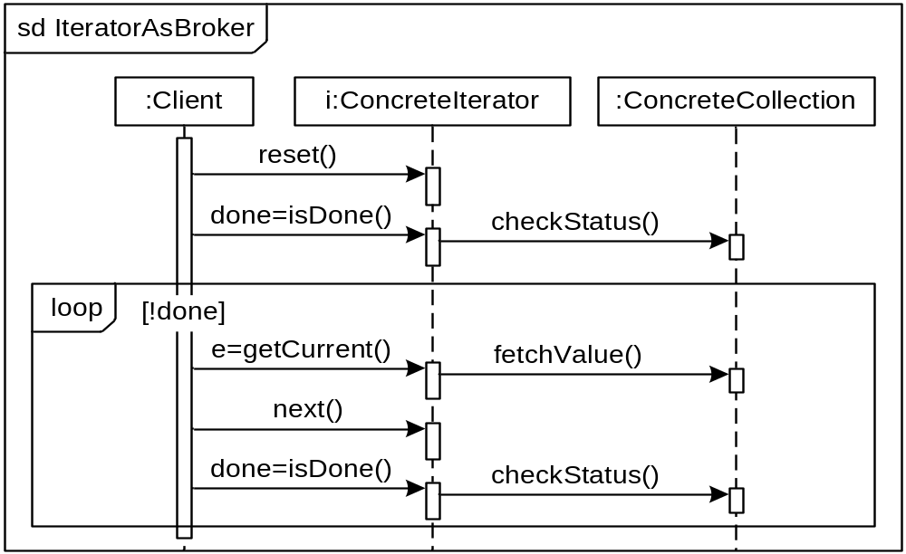
Broker Example: Iterator Behavior

Slide 24
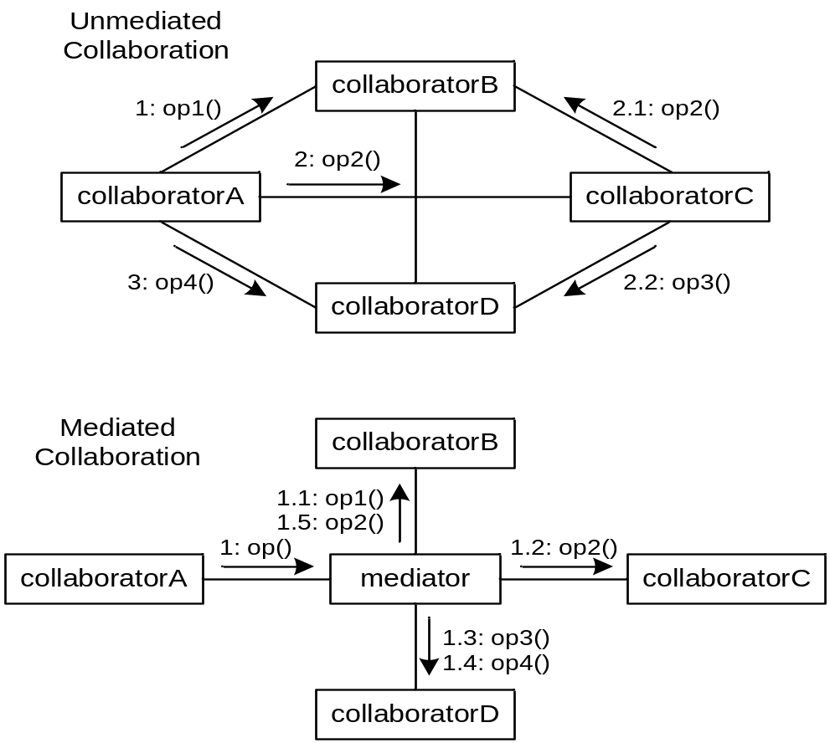
Using a Mediator

Slide 25
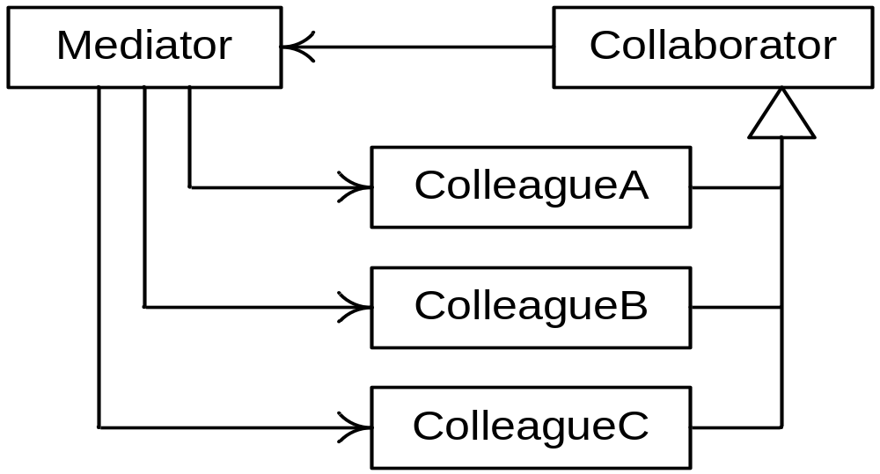
Mediator Pattern Structure

Slide 26
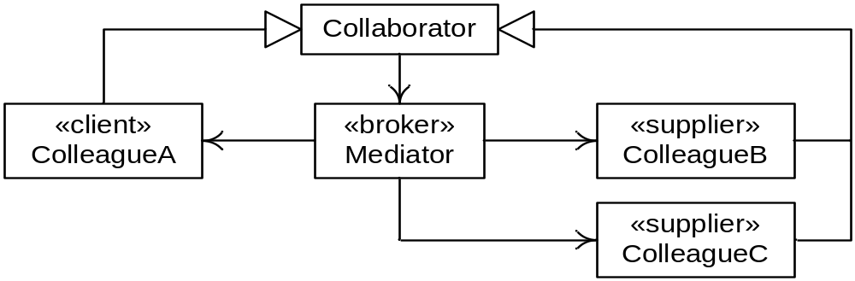
Mediator as a Broker

Slide 27
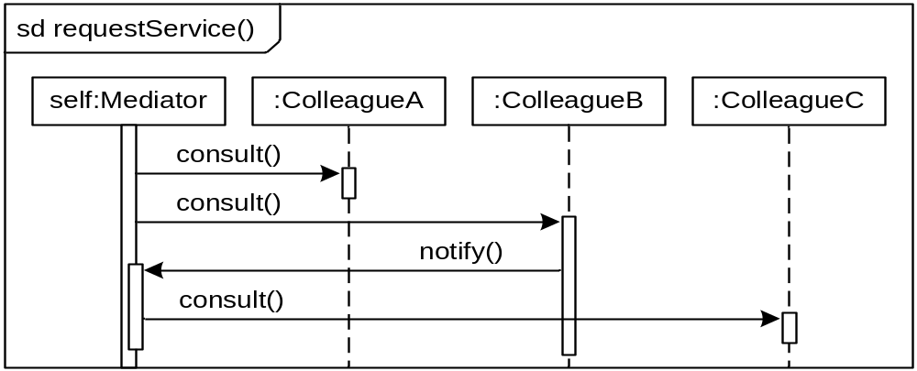
Mediator Behavior

Slide 28
When to Use a Mediator
Use the Mediator pattern when a complex interaction between collaborators must be encapsulated to
  Decouple collaborators,
  Centralize control of an interaction, and
  Simplify the collaborators.
Using a mediator may compromise performance.

Slide 29
Summary
Broker patterns use a Broker class to facilitate the interaction between a Client and a Supplier.
The Façade pattern uses a broker (the façade) to provide a simplified interface to a complex sub-system.
The Mediator pattern uses a broker to encapsulate and control a complex interaction among several suppliers.

Slide 30
Related Patterns
Facade: "Provides a unified interface to a set of interfaces in a subsystem. Facade defines a higher-level interface that makes the subsystem easier to use." In more simplified terms, the facade pattern provides unidirectional communication with subsystem classes. Mediator is multidirectional.

Slide 31
Related Patterns
Observer: Colleagues may communicate with a mediator using the observer pattern. In fact, this is very commonly used in conjunction with the Mediator, as it provides a facility by which the Colleagues may 'subscribe' to the Mediator, and thus alleviates the Mediator of the responsibility of having to know exactly what classes need to be informed of events.

Slide 32
Examples
Parliament
The House of Commons in the Parliaments of Canada, England and many more countries are also excellent real-life examples of the mediator pattern. According to protocols established hundreds of years ago, Members of Parliament (Colleagues) may never address each other directly. All comments are instead directed to the Speaker of the House (the Mediator). Further, it is a breach of protocol to refer to a member by name. All members are referred to as "The Honourable Member from [district]" or "My good friend from [district]." This is analogous to addressing Colleague classes by their "interface" and not by their actual "implementation".

Slide 33
Examples
Chatroom
To illustrate a possible use of the Mediator pattern, we have chosen to present an example chatroom application in Java. In this particular example, the Forum acts as the abstract Mediator, and the PoliticalForum is the concrete implementation of it. We then have a couple of Colleague implementations: MemberOfParliament, and PrimeMinister (PrimeMinister is actually a subclass of MemberOfParliament, so it too is a Colleague). By having each Colleague aware of the Forum they're participating in, they can send messages without actually referencing one another.

